Slide 1
The Earth System Grid Federation (ESGF)
This work was performed under the auspices of the U.S. Department of Energy by Lawrence Livermore National Laboratory under Contract DEAC52-07NA27344.
LLNL-PRES-732338
Task |  | R&D Area
1.1 |  | Data Management
1.2 |  | User Interface and Search
1.3 |  | Hardware & Network
1.4 |  | Data Transfer
1.5 |  | Installation (Containerized)
1.6 |  | Authentication & Authorization
1.7 |  | Federation
1.8 |  | Quality Control & Assurance
1.9 |  | Replication
1.10 |  | Distributed Search
1.11 |  | Metrics
1.12 |  | User Notification
1.13 |  | Long-tail Publication
1.14 |  | Distributed Computation
1.15 |  | Data Citation
2.1 |  | Provenance Capture
2.2 |  | Workflow
2.3 |  | Dynamic Resources
2.4 |  | In situ Analysis
2.5 |  | Machine Learning
2.6 |  | UQ
2.7 |  | Analytical Modeling
2.8 |  | Mobile Apps
Current capability status:
 | Usable
 | Prototype
 | Research activity
Overview
Dean N. Williams
Lawrence Livermore National Laboratory
2017 Triennial Project Review, Potomac, MD
June 8 – 9, 2017

Slide 2
The ESGF peer-to-peer (P2P) enterprise system is one of the largest-ever collaborative data efforts in Earth system science

Slide 3
ESGF members
(**) ESGF Executive Committee
(*) ESGF Team Lead
Name | Task | Presentation Title
Dean N. Williams (**) | All | ESGF Overview
Sasha Ames (*) | 1.1, 1.7, 1.12, 1.13, 1.15, 2.1 | Publication, Tracking and Feedback Notification (TFN), and Node Manager
Luca Cinquini (*, **) | 1.1, 1.2, 1.4, 1.8, 1.14, 2.1, 2.3, 2.8 | CoG User Interface (UI), Metadata and Search
Charles Doutriaux (*) | 1.1, 1.11, 1.14, 2.1, 2.2, 2.4, 2.5, 2.6 | Advanced Computational Environments and Data Analytics
Denis Nadeau | 1.1, 1.2, 1.7, 1.8, 1.10, 1.14, 2.1, 2.4 | Community Data Management System (CDMS) & Climate Model Output Rewriter (CMOR)
Jason Bouttee | 1.1, 1.2, 1.11, 1.14, 2.1, 2.2, 2.6 | Server-side Computing: Application Programming Interface (API)
Zeshawn Shaheen | 1.14, 2.5 | Diagnostics and Metrics
Williams Hill (*) and Luca Cinquini (*, **) | 1.3, 1.5, 1.7, 1.8, 2.1 | Software Installation
Soo Kyung Kim | 2.5 | Machine Learning
Jim McEnerney | 2.6, 2.7 | Uncertainty Quantification (UQ) and Analytical Modeling (AM)
Ji-Woo Lee | 1.14, 2.1, 2.4, 2.5, 2.6 | Scientific Contributions of ESGF to Research Communities
Cameron Harr | 1.2, 1.3, 1.4, 1.13, 1.14, 2.2, 2.3, 2.7 | Hardware & Network and Data Transfer
Matthew Harris (*) | All | User Support and Documentation

Slide 4
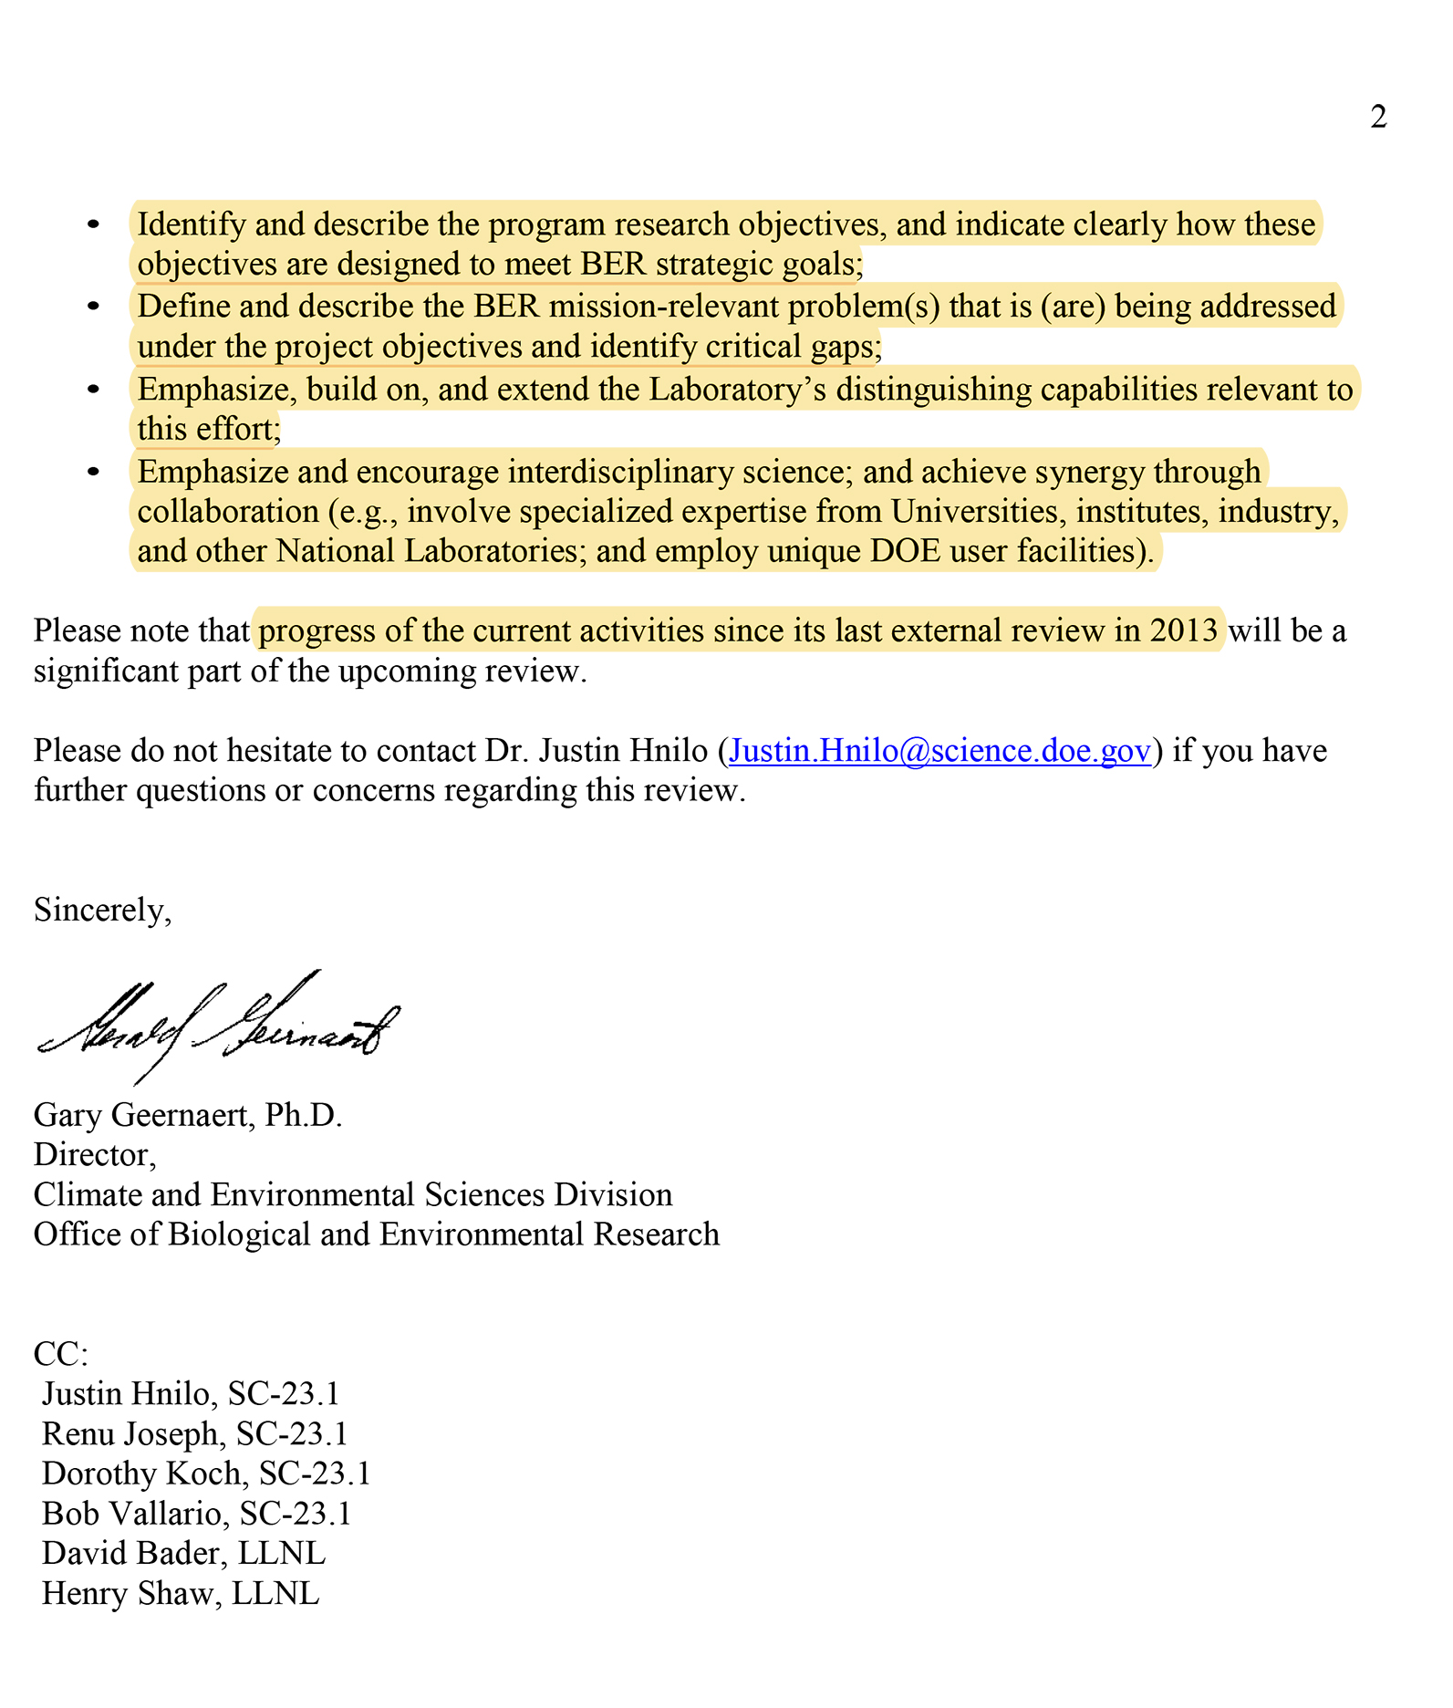
Our charge

Slide 5
Interpretation of charge
There are several BER initiatives under way to address the challenges of big data
Scope of this proposal was restricted to data-intensive science applications for CMIP, ACME, and other BER Virtual Data Integration (or Virtual Laboratory) projects
Timeframe assumed ended in the year 2020
Charge asked for identification of investments that are most likely to positively impact both data-intensive science research goals (i.e., CMIP) and exascale computing goals (i.e., ACME)
Leadership Compute Facilities (NERSC, OLCF, ALCF)
Notes:
There are several BER initiatives under way to address the challenges of big data
Scope of this proposal was restricted to the intersection of big data challenges and exascale computing in the context of data-intensive science applications for CMIP, ACME, and BER’s Virtual Data Integration (or Virtual Laboratory)
Timeframe assumed was the end of year 2020 (when CMIP6 is expected to be completed (i.e., ~2019) and exascale capability is expected on the horizon ~2022)
Nearer term considerations also received attention since they will influence the migration path for both CMIP and ACME data integration
Charge asked for identification of investments that are most likely to positively impact both data-intensive science research goals (i.e., CMIP) and exascale computing goals (i.e., ACME)
Since Leadership Compute Facilities (NERSC, OLCF, ALCF) are a primary focus for some BER data activities (e.g., ACME), this proposal also focuses on investments that can leverage synergies between data-intensive science and the potential use of peta- / exascale computing facilities. This also includes facilities at non LCFs, such as those at LLNL.

Slide 6
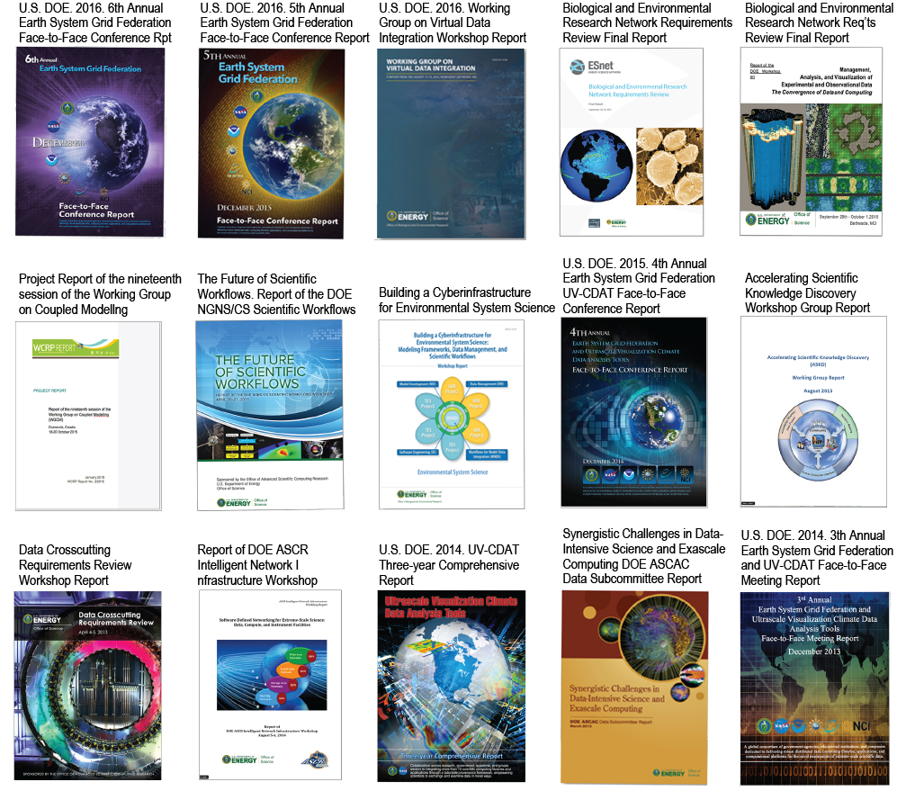
Context for our charge and proposal
Outreach and engagement
Contributions to data science
findings and recommendations
Notes:
Outreach and engagement to help the community achieve next steps
Contributions to data science workshops and conference reports
Workshop reports findings and recommendations

Slide 7
Outline
Strategic vision and goals
Roadmap
Strategic implementation plan:
Evolution of community-base data ecosystem
What’s next?
Lessons learned and discussion
Notes:
Strategic vision and goals: High-end view, broader data and federation enterprise
Roadmap: Where to go in 1-3 years, more detail, longer view
Strategic implementation plan: What to do now (next 1-2 years), move towards vision of Strategic Plan and Roadmap
Evolution of community-base data ecosystem
What is BER’s data vision for the community? How do we get there? Who’s involved?
What’s next?
Upcoming data development/transitions: What is on the the horizon?
Lessons learned and discussion

Slide 8
Strategic vision and goals
Notes:
Setting the strategic vision and defining goals are not easy tasks for a ever demanding community.
Must re-evaluate every strategic vision and goals every year and re-write every three-years.

Slide 9
Vision: sustain and innovate a data-sharing ecosystem for scientific research and discovery
Earth System Grid Federation (ESGF) overall goals Include:
Support BER’s and community’s missions and strategic vision
Ensure technical and developmental integrity of the ESGF software infrastructure and data ecosystem
Anticipate cutting-edge technologies and their use within the federation
Attract and retain the most qualified scientists and software engineers and enable them to enhance their skills and expertise through leveraging interagency proposals and external projects
Enable scientific collaborations with academia, industry and other national and international government laboratories and agencies
Notes:
Led by the U.S. Department of Energy’s (DOE) Office of Biological and Environmental Research (BER), this international multi-agency federation—which heavily relies on European partners—develops, deploys, and maintains software to facilitate advancements in geophysical science. ESGF’s open-source, operational code base disseminates model simulation, observational, and reanalysis data for research assessments and model validation via secure storage and dissemination of petabytes of data.

Slide 10
Distributed archives
Earth system science supported projects
CMIP3, CMIP5, and CMIP6—Phases 3, 5, and 6 of the Coupled Model Intercomparison Project
CORDEX—Coordinated Regional climate Downscaling Experiment
ACME—Accelerated Climate Modeling for Energy
EUCLEIA—EUropean Climate and weather Events: Interpretation and Attribution
Obs4MIPs—Observational for Model Intercomparison Project
GeoMIP—Geo-engineering Model Intercomparison Project
Ana4MIPs—Reanalysis for the coupled model intercomparison
LUCID—Land-Use and Climate, Identification of robust impacts
ESA CCI—European Space Agency Climate Change Initiative Earth Observation data
TAMIP—Transpose-Atmospheric Model Intercomparison Project
PMIP—Paleoclimate Modeling Intercomparison Project
HIWPP—High Impact Weather Prediction Project
NEMS—NOAA Environmental Modeling System
NEX-DCP30—NASA NEX Downscaled Climate Projections
CREATE-IP—Collaborative REAnalysis Technical Environment – Intercomparison Project
More complete list: https://esgf-node.llnl.gov/ac/list/
Notes:
Primary support for Coupled Model Intercomparison Project (CMIP) activities and prepare for future assessments.

Slide 11
Scientific and technical merit of the ESGF proposal
Innovative and Creativity:
Only system to offer distributed data and allow interoperability among disparate data sets for scientific assessment study.
Impact on the Community:
18 highly visible national and international climate data products including CMIP3, CMIP5, and soon CMIP6
>5 PB of distributed community data, expected to expand beyond >20 PB (compressed)
25 registered nodes at climate research centers spread across 21 countries
>25,000 registered users
1,000’s of peer-reviewed publications prepared using the ESGF data and resource
Qualifications and Resources:
Built on decades of evolution and community service
Supports multi-agency shared resources throughout the federation
Sustainability and Reliability:
Much of the scientific data backbone of all 5 assessment reports of the United Nations’ Intergovernmental Panel on Climate Change (IPCC), dating from 1990 to 2013
Tasked with preparing for the sixth phase (CMIP6), which will inform the next IPCC Assessment, due for publication in 2019-2020
Notes:
ESGF has transformed Earth system data into community resources available within a virtual, collaborative environment that links climate centers and users around the world to models and data via a computing grid power by the world’s supercomputing resources and the Internet.

Slide 12
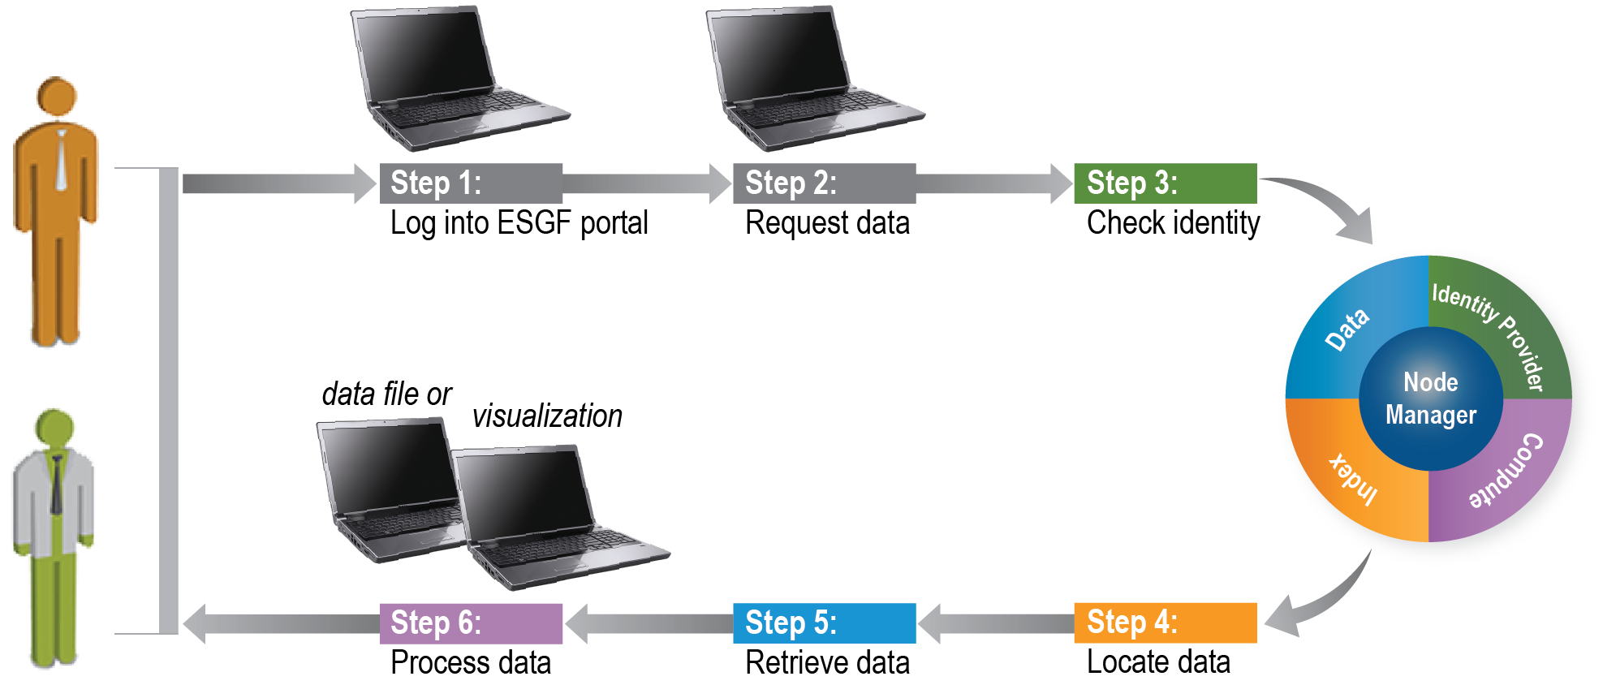
Scientific and technical merit of the ESGF proposal
Easy to use
Policy Maker
Science User
Notes:
The ESGF infrastructure enables scientists to evaluate models, understand their differences, and explore the impacts of geophysical disturbances through a common interface, regardless of data location.

Slide 13

ESGF R&D Goals
Sustain and enhance a resilient data infrastructure with friendlier tools
Prototype new tools that fill important capability gaps
Notes:
Sustain and enhance a resilient data infrastructure with friendlier tools for the expanding Earth system science community
Prototype new tools that fill important capability gaps in scientific data archiving, access, and analysis

Slide 14
R&D Goals are based on our survey findings
Server-Side Computing:
Download only needed data portions rather than entire large datasets
Accommodate and prioritize 10,000’s of ESGF users.
Persistent Identifiers (PIDs):
Versioning and citation tools and services for CMIP6
Errata
Un-publish
Provenance Capture:
Matured capabilities to capture provenance information:
Easily reproduce server-side analyses and products for users requesting the results of work entered into reports or journal articles
Installation and Docker:
Easier installation of ESGF software:
Software must work within a secure software container (e.g., Docker) that meets the federation’s software security concerns
Notes:
Server-Side Computing
Easier process for scientists to download only their needed data portions rather than entire large datasets (i.e., subsetting, averaging, and regridding). These capabilities will be sufficient for 70% to 80% of all user server-side computing requests. In addition, resource management strategies must be in place to accommodate and prioritize the tens of thousands of ESGF users.
Persistent Identifiers (PIDs)
Development of versioning and citation tools and services (e.g., errata and “un-publish” features). Progress is being made, and these capabilities must be in place for CMIP6.
Provenance Capture
Matured capabilities to capture provenance information for component integration and usability by projects and the user community. For example, there is a need for the provenance environment to easily reproduce server-side analyses and products for users requesting the results of work entered into reports or journal articles.
Installation and Docker
Easier installation of ESGF software. Continuing to address this challenge are various working teams. Part of the task includes having the software work within a secure software container (e.g., Docker) that meets the federation’s software security concerns.

Slide 15
Strategic approach for scientific data management and integration
Our strategic vision is to work in a multi-institutional Agile development environment to make short- and long-term state-of-the-art iterative improvements to national and international data archiving, access, and analysis systems
This long-term vision is codified in a mature strategic plan (https://esgf.llnl.gov/media/pdf/2015-ESGF-Strategic-Plan.pdf)
Followed by a working implementation plan (https://esgf.llnl.gov/media/pdf/ESGF-Implementation-Plan-V1.0.pdf)
Concurrent planning and doing approach
Executive Committee: high-level broad strategic plan + accompanying detailed Implementation roadmap documents
Team Leads: Short-term (0-1 year) implementation development actions combined with longer-term implementation endeavors

Slide 16



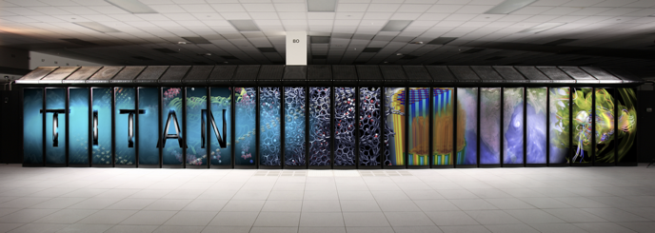
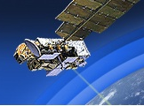
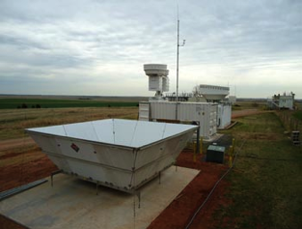

Integrated data ecosystem
Data Collection and Management
Sensors, field and lab experiments
Data models
Transport and communications
Data quality and uncertainty
Storage, provenance and discovery
Security
Provenance
Capture
Critical Complex Data Generation Systems
Data Analytics (local & remote)
Descriptive statistics
Graph analytics
Machine learning
Signal and image processing
Pattern discovery
Visualization
Exploratory analysis
Data-Intensive Computing
Architectures – persistent data to streams
Programming environments
Human computer interface
Decisions and Control Design Optimization Policy Making
(Humans)
Understanding and predicting use
Analytical Modeling
Network
Notes:
Enabling integrated research
Data Center and interoperable services
Virtual Laboratory infrastructure

Slide 17
Strategic vision: key elements
Focus on geoscience projects that want their data federated throughout the community and with other projects’ data for possible intercomparison and knowledge discovery (i.e., CMIP, ACME, Obs4MIPs, etc.)
There are many and include the heterogeneous data sets from simulation, observation, reanalysis, and many other climate related communities
Sustain and enhance a resilient data infrastructure with friendlier tools for the expanding global scientific community
Focus on hardware, network and other data center resources
Prototype new tools that fill important capability gaps in scientific data archiving, access, and analysis
Same standards for all who choose to participate and contribute
Transparent and robust governance
Notes:
Update or refresh technologies implemented within the ESGF software stack such as adopting CoG, the new Web user front-end interface; completely re-writing the node manager, used for peer-to-peer node communications; improving the software installation, making it easier for administrators to selectively install components for their site; and updating security, user authentication and authorization for access to federated data and managed resources.

Slide 18
Roadmap
Notes:
The project that fails to plan, plans to fail.
Roadmaps are important to map out where you have been and where you are going.

Slide 19
Collaborative roadmap: past and future
Notes:
Roadmap of decades of iterative improvements addressing community requirements
Future roadmap covers gaps needed for systematic and efficient data management, integration, and discovery

Slide 20
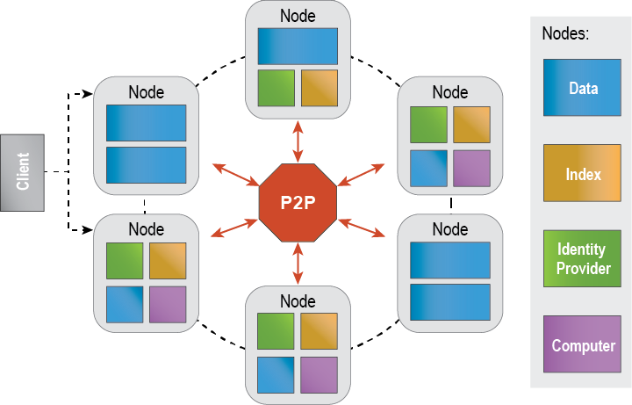
Federated distributed data archival and retrieval system architecture
Notes:
Federated peer-to-peer architecture
Support discipline-specific portals
Support browser-based and direct client access
Single sign-on
Automated script and GUI-based publication tools
Full support for data aggregations
Distributed, federated metadata searches

Slide 21
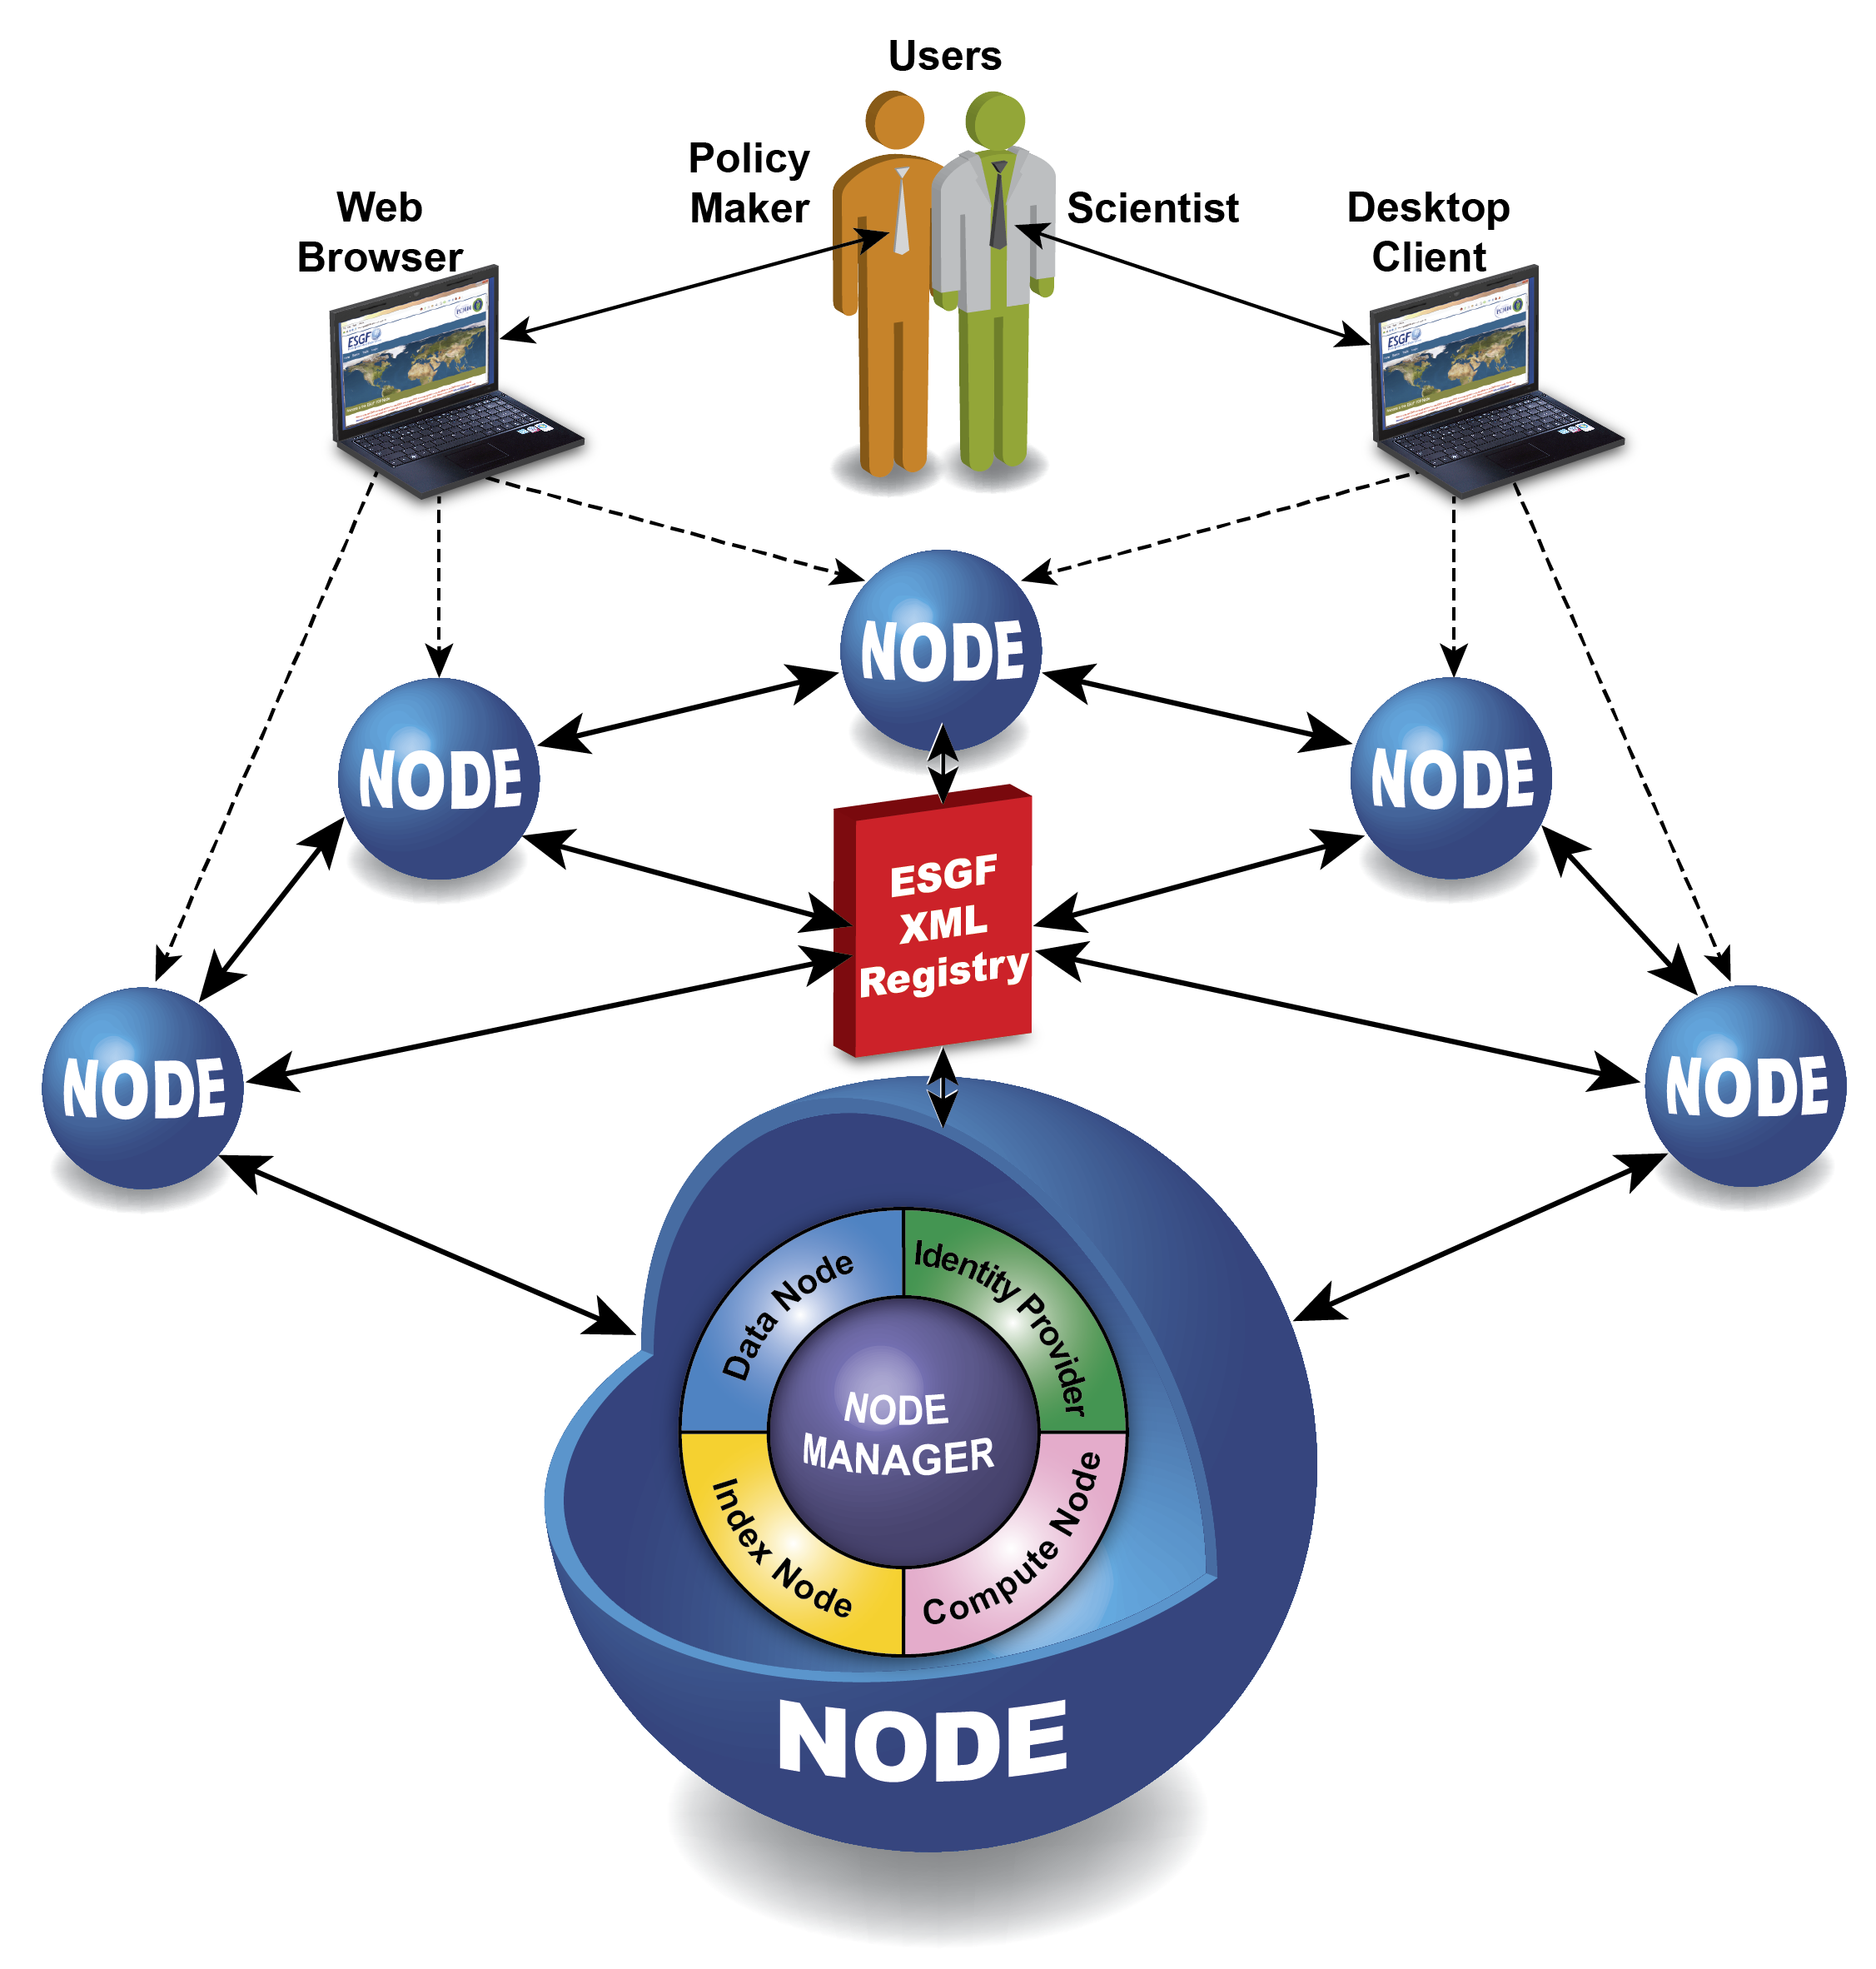

Roadmap to a new architecture
ESGF Software Modules – REST APIs
Publishing
Services
Search
Services
Transfer
Services
Compute
Services
Analytics
Services
Diagnostics
Services
Visualization
Services
Machine Learning
Services
Exploration
Services
Monitoring
Services
Resource
Services
Network
Services
Workflow
Services
Security
Services
Provenance
Services
Site 1
Site 2
Site N
ESGF Software Modules – REST APIs
ESGF Software Modules – REST APIs
ESGF Software Modules – REST APIs
Node 1
Node 2
Virtual Organization
Node n
Metadata
Catalogues
Metadata
Catalogues
Metadata
Catalogues
Data Storage
Data Storage
Data Storage

Slide 22
User survey results (2016)
Users
Profession
Affiliation
Quantity
Operating System
Access
Notes:
Full 2016 survey results can be seen in the 2017 ESGF F2F Conference Report, section 2.

Slide 23
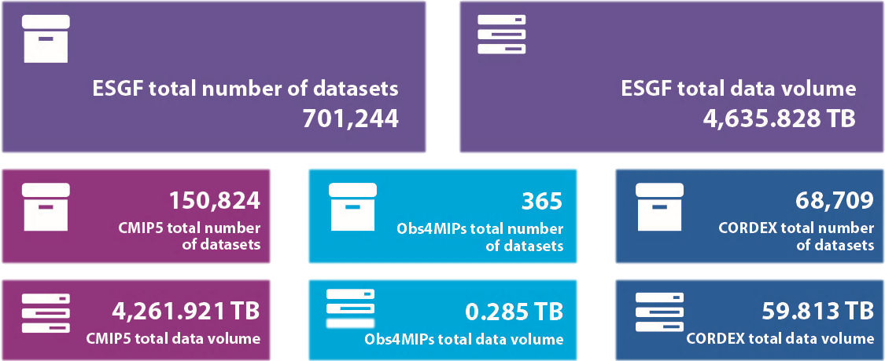
Use demographics
Statistics Overview
Notes:
Over 5PB of data severed up to the community.
Focus here is on the CMIP archive, but we are collaborating with the community such as the NASA led Obs4MIPs and the EU led CORDEX.

Slide 24
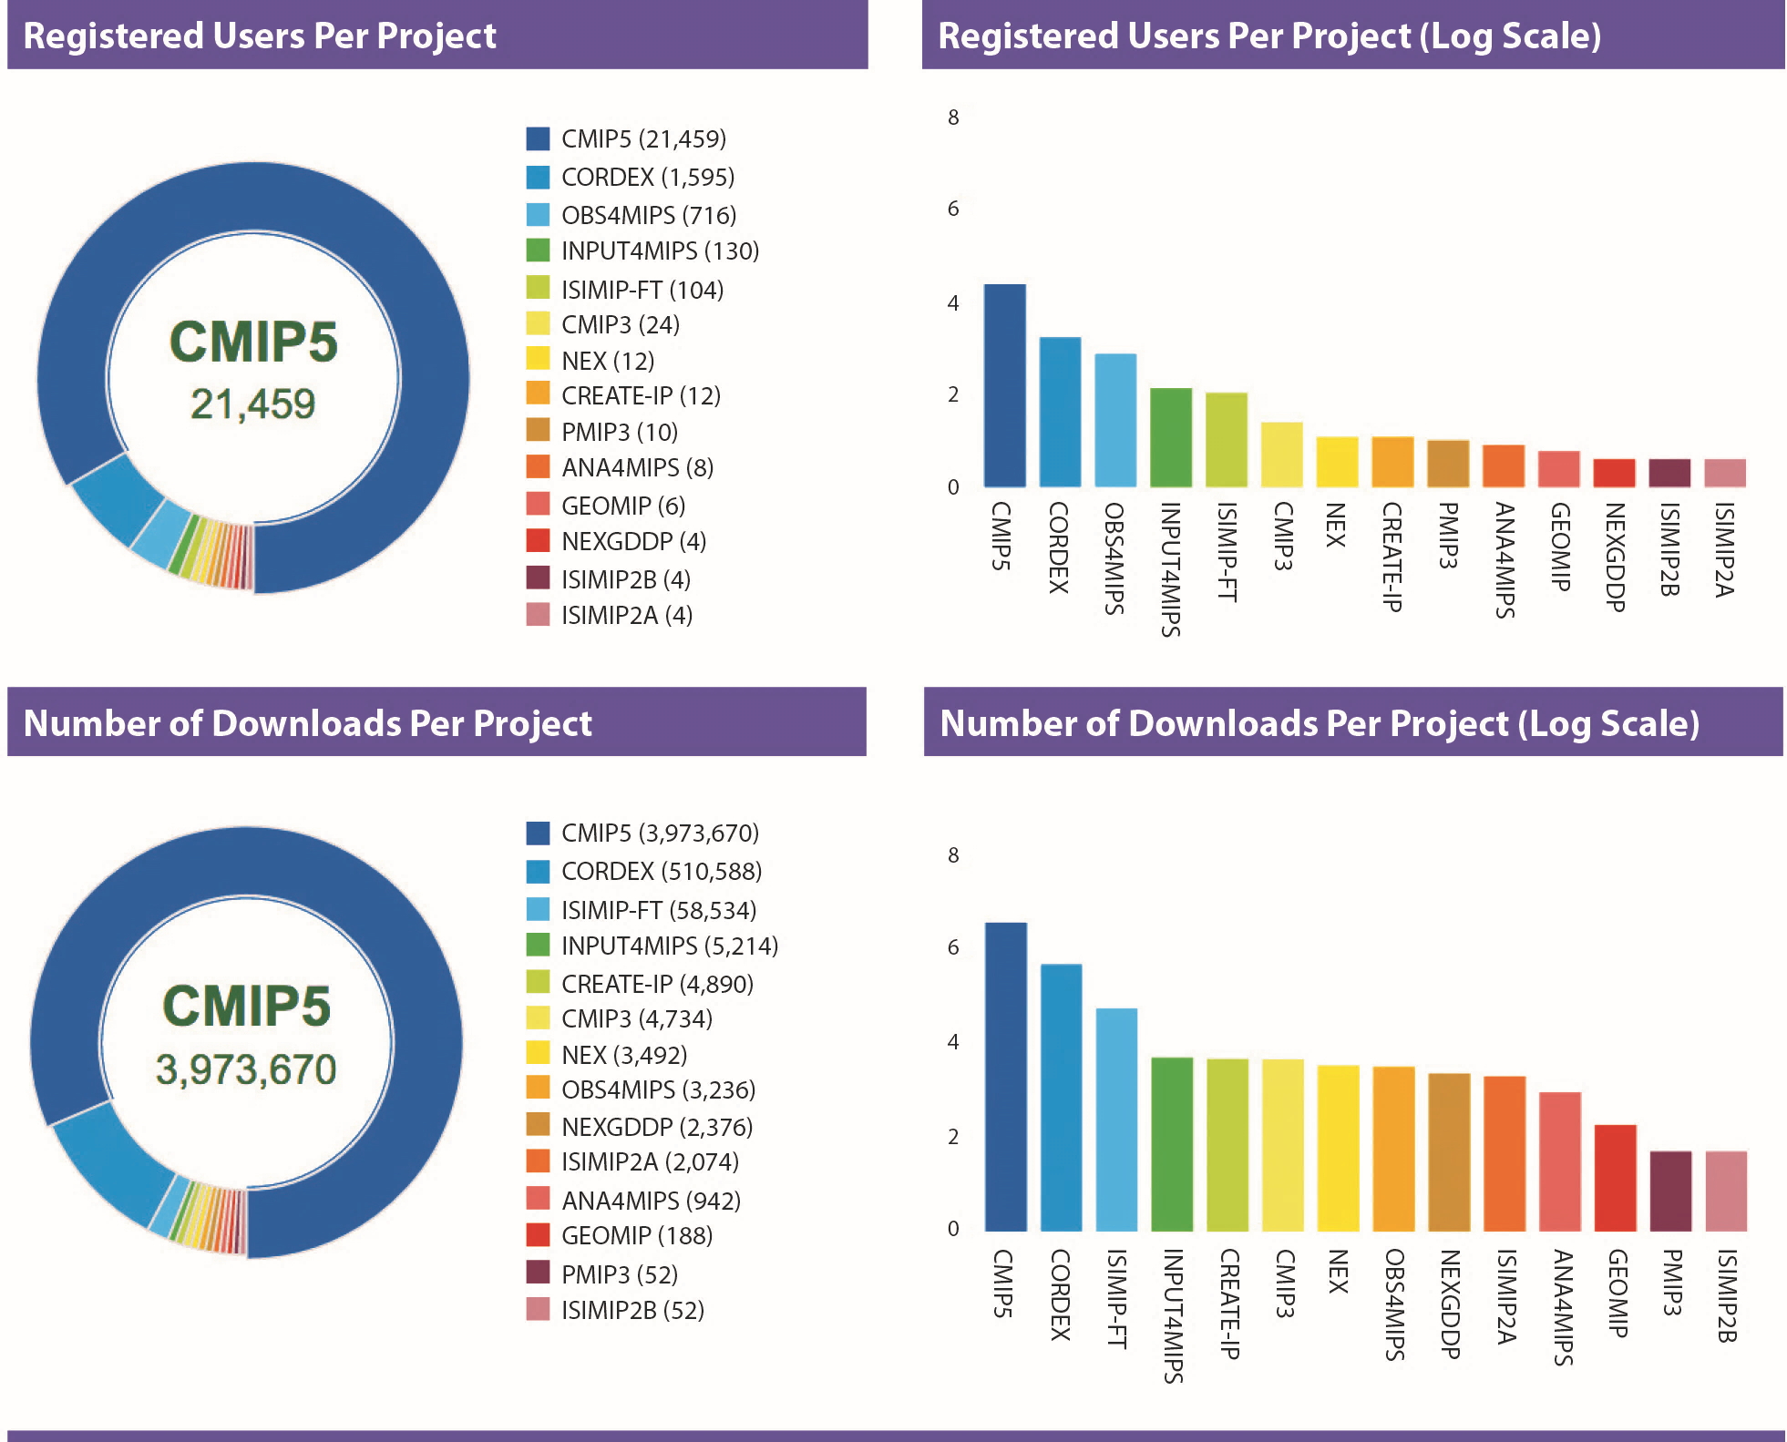
Use demographics
Registered
Users Per
Project
Downloads
Per Project
Notes:
Full 2016 usage demographics results can be seen in the 2017 ESGF F2F Conference Report, section 3.

Slide 25
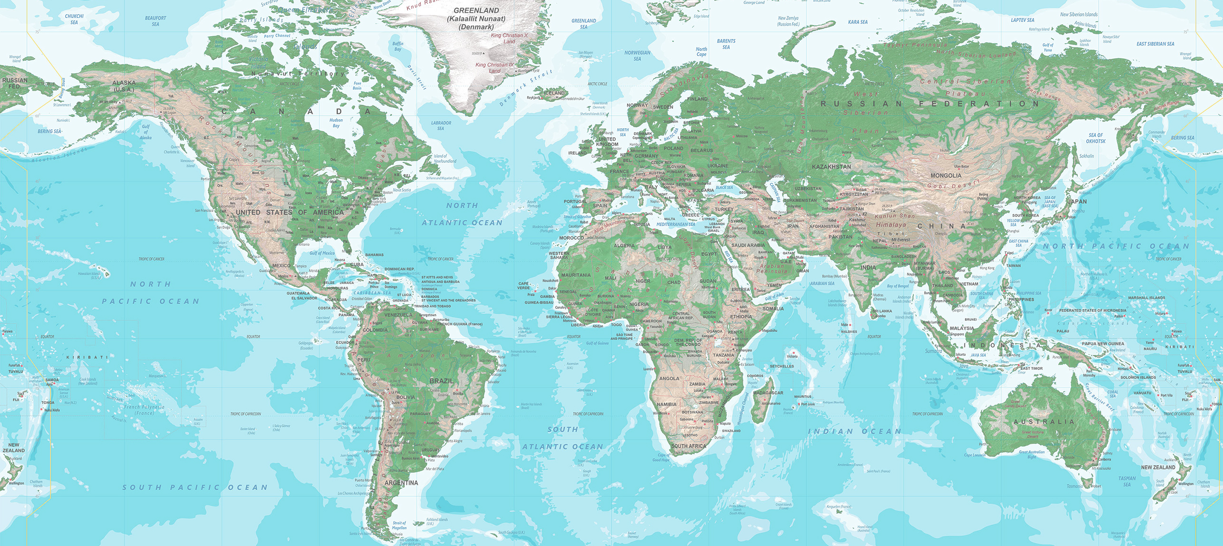
Use demographics
Downloads by Continent and Country
Europe
13,315,659
Asia
16,928,357
North America
13,052,021
Africa
249,951
South America
1,010,049
Oceana
4,718,743

Slide 26
Use demographics
Registered Users by Continent and Country
Europe
3,169
Asia
5,024
North America
4,032
Africa
470
South America
710
Oceana
350

Slide 27
ESGF comparison to other archives
Notes:
Through proposed work, ESGF will add needed capabilities for:
Server-side computing access and analysis
Provenance capture
Dynamic resource management
Machine learning
Data citation
Long-tail publishing

Slide 28

Over the past three years, the ESGF team has published over combined workshop reports, peer-reviewed journal articles, and citable software DOIs
70

Slide 29
Strategic Implementation Plan

Slide 30
Strategic and implementation documents (1)
Living Document | Web Link | Description
Governance | https://esgf.llnl.gov/media/pdf/ ESGF_Governance_6_4_2015.pdf | ESGF governance structure
Strategic Roadmap | https://esgf.llnl.gov/media/pdf/2015-ESGF-Strategic-Plan.pdf | ESGF mission and international integration strategy for data, database and computational architecture
Implementation Plan | https://esgf.llnl.gov/media/pdf/ESGF-Implementation-Plan-V1.0.pdf | ESGF data management system: deployment, installation, and transition to an operational system.
Software Security Plan | https://esgf.llnl.gov/media/pdf/ ESGF-Software-Security-Plan-V1.0.pdf | Systematic approach to releasing a secure ESGF software stack to the community

Slide 31
Strategic and implementation documents (2)
Living Document | Web Link | Description
Policies and Guidelines | https://esgf.llnl.gov/media/pdf/ESGF-Policies-and-Guidelines-V1.0.pdf | Uniform standards for all participants/contributors in the global infrastructure environment
CA Policy | https://esgf.llnl.gov/media/pdf/ESGF-CA-V2.0.pdf | Rules and procedures established for the operation of the ESGF Root CA PKI services
Tier 1 and 2 Node Site Requirements | https://esgf.llnl.gov/media/pdf/ESGF-Tier1and2-NodeSiteRequirements-V5.pdf | Requirements for two classes of distinguished ESGF node types: Tier 1 and 2 node sites
Logo Requirements | https://esgf.llnl.gov/logo_ requirements.html | Logo requirements and guidelines for ESGF and CoG

Slide 32
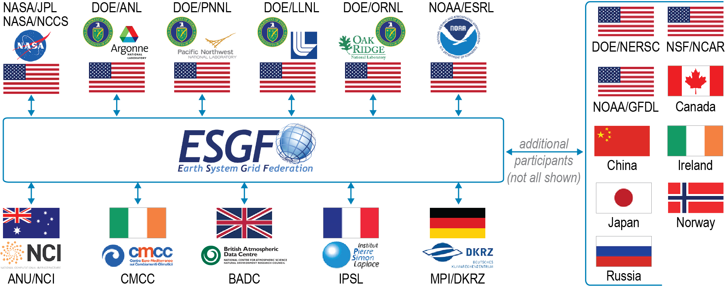






Sponsoring national and international agencies
Agency Sponsors
DOE
IS-ENES
NASA
NCI
NOAA
NSF
ESGF Steering Committee: Justin Hnilo (Chair, DOE), Sylvie Joussaume (IS-ENES), Tsengdar Lee (NASA), Ben Evans (NCI), Annarita Mariotti (NOAA)
ESGF Executive Committee: Dean N. Williams (Chair, DOE), Michael Lautenschlager (co-Chair, DKRZ), Sébastien Denvil (IPSL), Martin Juckes (STFC), Luca Cinquini (NASA/NOAA), Robert Ferraro (NASA), Daniel Duffy (NASA), Cecilia DeLuca (NOAA), V. Balaji (NOAA)

Slide 33
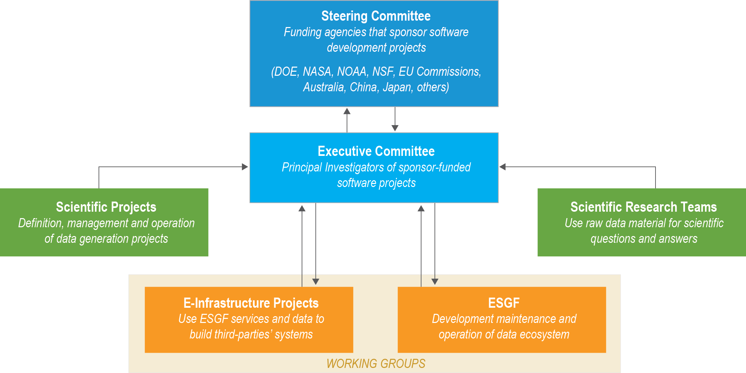
Governance communication structure

Slide 34
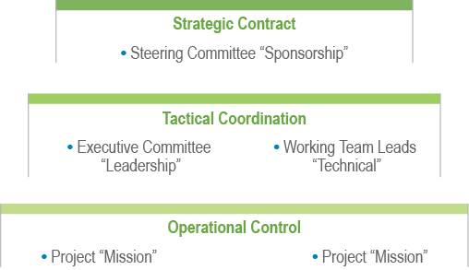
Governance communication structure

Slide 35
ESGF sub-tasks and team leaders
Sub-Task | Team Leads and Funding Agencies / Institution | Description
1. User Interface and Search and Dashboard Working Team | Luca Cinquini (NASA) and Guillaume Levavasseur (IPSL) and Alessandra Nuzzo (CMCC) | Improved ESGF search and data cart management and interface; ESGF search engine based on Solr5; discoverable search metadata; Statistics related to ESGF user metrics
2. Compute Working Team | Charles Doutriaux (DOE) and Daniel Duffy (NASA) | Developing the capability to enable data analytics within ESGF
3. Identity Entitlement Access Working Team | Philp Kershaw (CEDA) and Lukasz Lacinski (ANL) | ESGF X.509 certificate-based authentication and improved interface
4. Installation Working Team and Software Security Working Team | William Hill (DOE) and George Rumney (NASA) and Prashanth Dwarakanath (LiU) | Installation of the components of the ESGF software stack; Security scans to identify vulnerabilities in the ESFF software;
5. International Climate Network Working Group, Replication/Versionin,g and Data Transfer Working Team | Eli Dart (DOE/ESnet) and Lukasz Lacinski (DOE) and Stephan Kindermann (DKRZ) | Increase data transfer rates between the ESGF climate data centers; Replication tool for moving data from one ESGF center to another; ESGF data transfer and enhancement of the web-based download
6. Node Manager Working Team and Tracking / Feedback Notification Working Team | Sasha Ames (DOE) and (Tobias Weigel (DKRZ) | Management of ESGF nodes and node communications
7. Publication, Quality Control, Metadata, and Provenance Capture Working Team | Sasha Ames (DOE) and Katharina Berger (DKRZ) and Bibi Raju (DOE) | Capability to publish data sets for CMIP and other projects to ESGF; Integration of external information into the ESGF portal
8. User Support and Documentation Working Team | Matthew Harris (DOE) also (includes representatives from the data centers (Tier 1), modeling centers (Tier 2), and the above working teams) | User frequently asked questions regarding ESGF and housed data; Document the use of the ESGF software stack

Slide 36
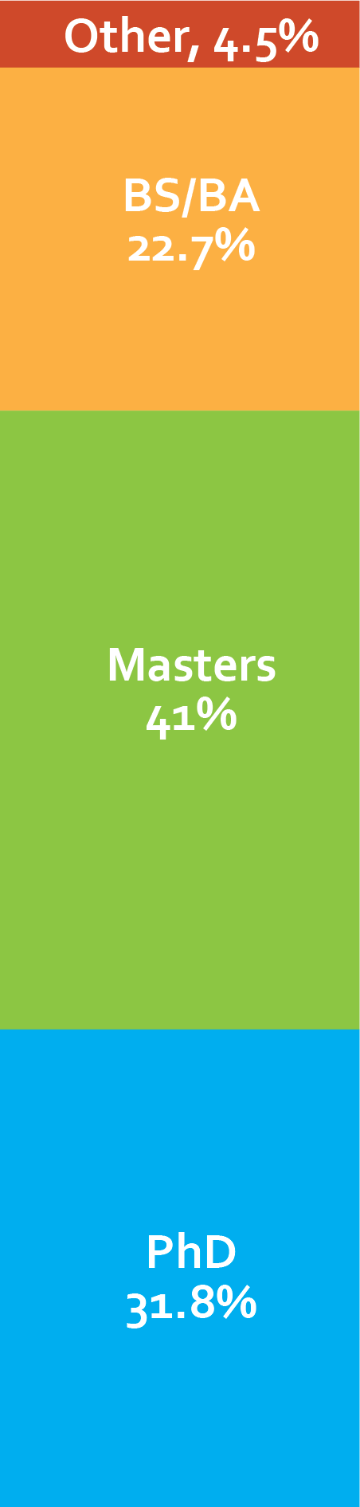
U.S. multidisciplinary team

Slide 37
Agile project management tools and websites
Public
GitHub
Confluence

Slide 38











ESGF software system and science integration
Operations
Uncertainty
Quantification
Distributed
Computing
Community
Machine
Learning
Provenance
Capture
Long-tail
Publication
CDMS
Cloud
CMOR
Analytical
Modeling
CF
In situ
Analysis
Metrics
Research
Development
Notes:
NetCDF Climate and Forecast (CF) metadata convention, CDMS
Climate Model Output Rewriter 3 (CMOR-3), controlled vocabulary
Publishing
Search and discovery
Replication and transport
Data Reference Syntax (DRS)
Earth System Documentation (ES-DOC)
Quality Control (QC)
Websites and Web portal development
Security
Notifications, monitoring, metrics
Product services

Slide 39
Data federation services
Community maintains and controls ownership of data
Community contributes to hardware and network infrastructure

Slide 40
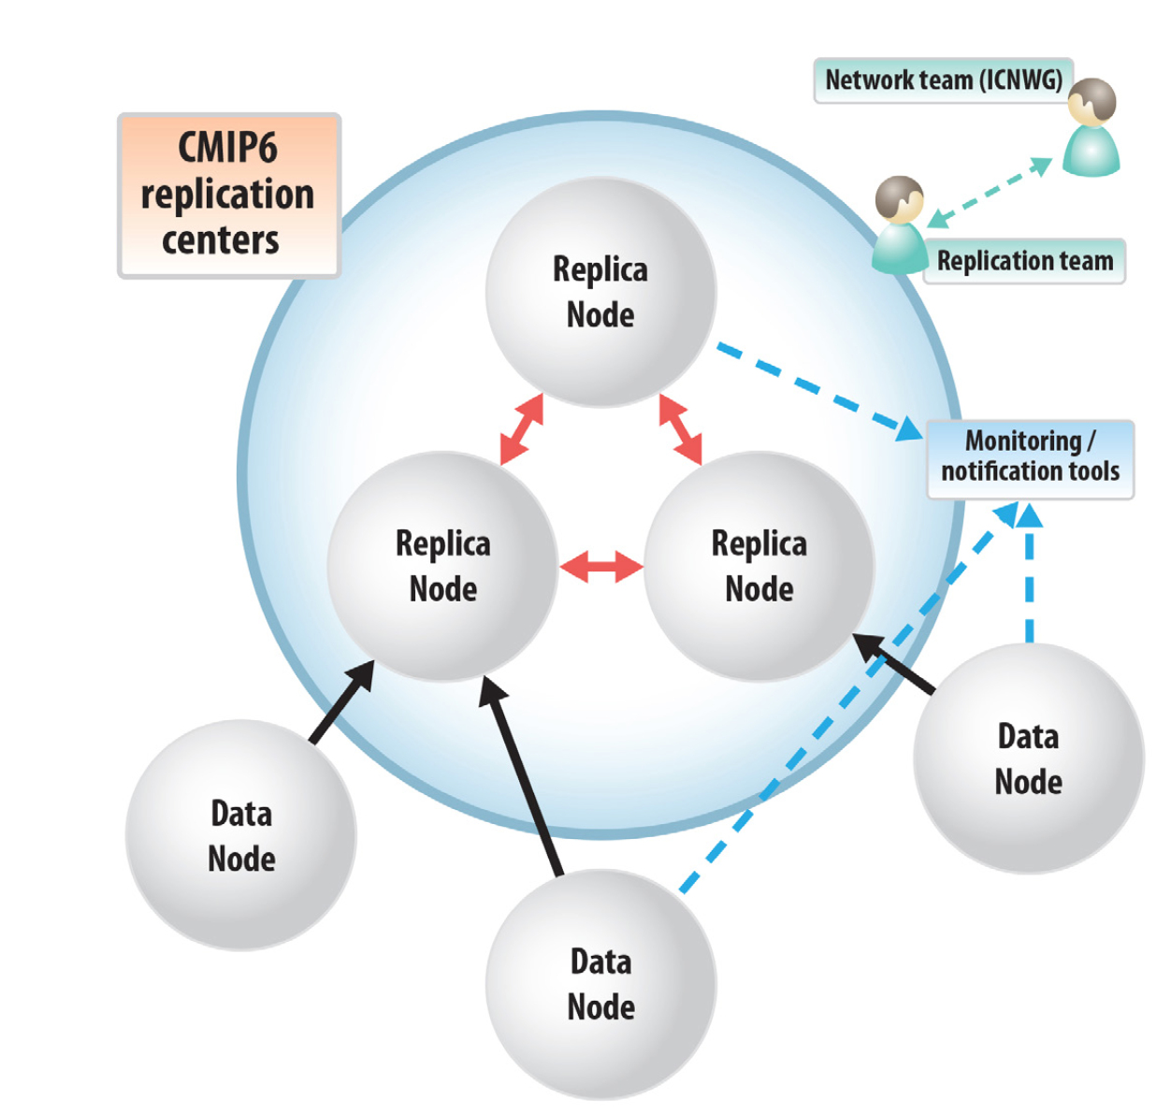
ESGF Tier 1 and Tier 2 node site requirements for CMIP6
Tier 1 sites requirements
Tier 1 sites are expected to run the full suite of ESGF services for data and user management, which can be used to support their own activities and those of Tier 2 sites
Have an uptime (>98%)
Have 10 petabytes of spinning disk storage space
Have at least a 10 gigabits per second connection to their wide- area network provider with plans to upgrade beyond 10Gbps by 2017
Run a 10 gigabits per second perfSONAR host (preferably on a physical server),
Deploy at least four 10 gigabits per second Data Transfer Nodes (DTNs) in a “Science DMZ” environment with plans to run production ESGF data services on the DTNs by 2017
Deploy sufficient high-performance storage to allow the DTNs to effectively serve CMIP6 data at high performance levels
Publish data using GridFTP and Globus URLs in addition to wget URLs,
Configure the DTNs to use Globus as well as GridFTP and wget, and
Use Synda for data replication between Tier 1 sites.
Core monitoring services
Unnoticed downtime by system administrator should not happen
Certificates end of validity monitoring
Quality of Service (TBD)
Tier 2 sites requirements
Centers that typically have fewer physical or staff resources available for ESGF interactions but that still need to distribute a certain (possibly significant) amount of data to the scientific community.
Tier 2 sites are encouraged to leverage some of the services supported by Tier 1 sites, such as a Metadata Index and Identity Provider, and focus instead on supporting local services for data download and possibly analysis.
LLNL
CEDA
DKRZ
Model Center 3
Model Center 1
Model Center 2

Slide 41
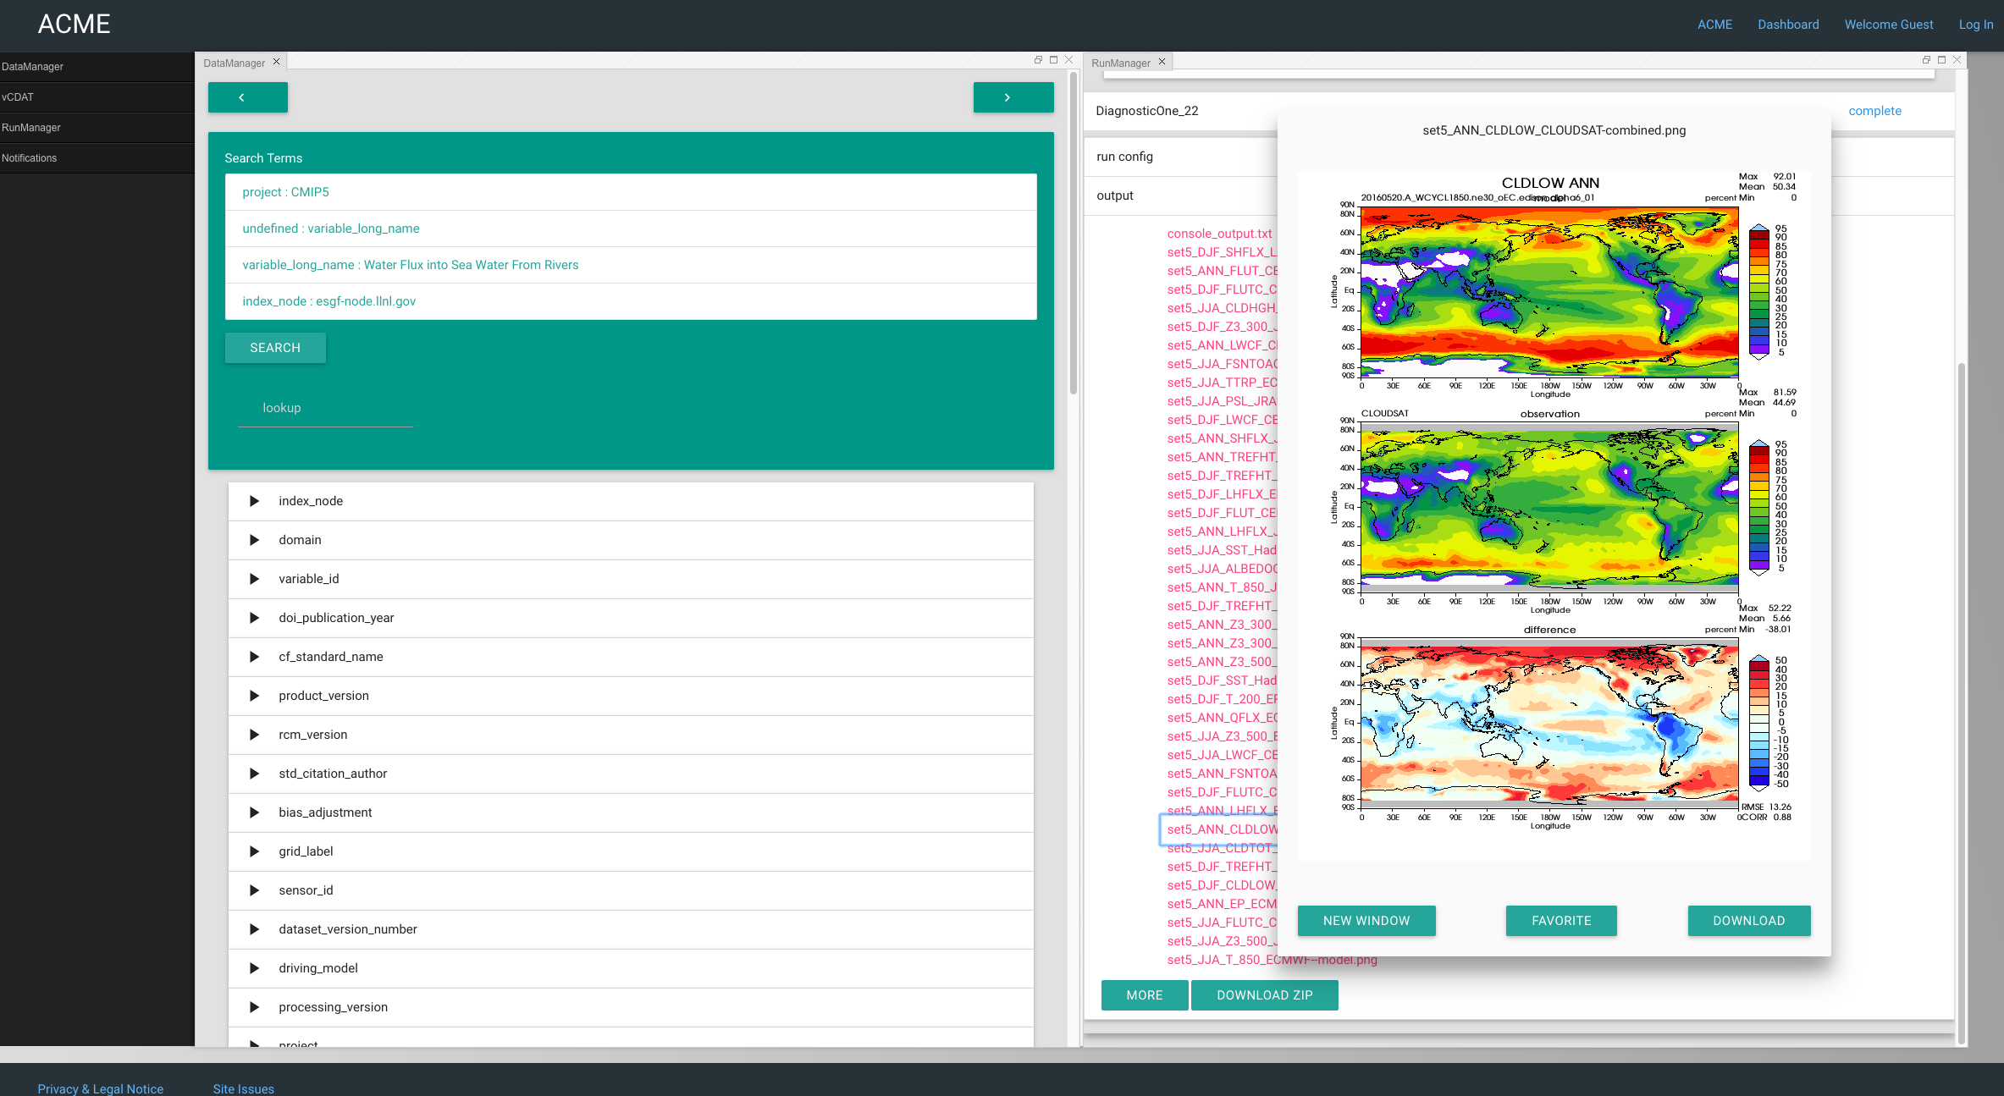
ACME workbench
Setting up a diagnostic run
Diagnostic output in the Workbench
Data Management
Community
Diagnostics Package
Notes:
Create a unified user interface for running and analyzing the ACME model
Give ACME team members the ability to configure, run, monitor, analyze, and save ACME climate model output through the browser

Slide 42
Reliance on the ESGF data infrastructure
Notes:
National and international scientific gateways
Supporting a broad range of activities that require ongoing access to disparate data sets (i.e., model output, observations, and reanalysis)
ESGF archives are important to Earth system science research missions and are representative of data sources used to advance Earth system science

Slide 43
Evolution of a community-based data ecosystem

Slide 44
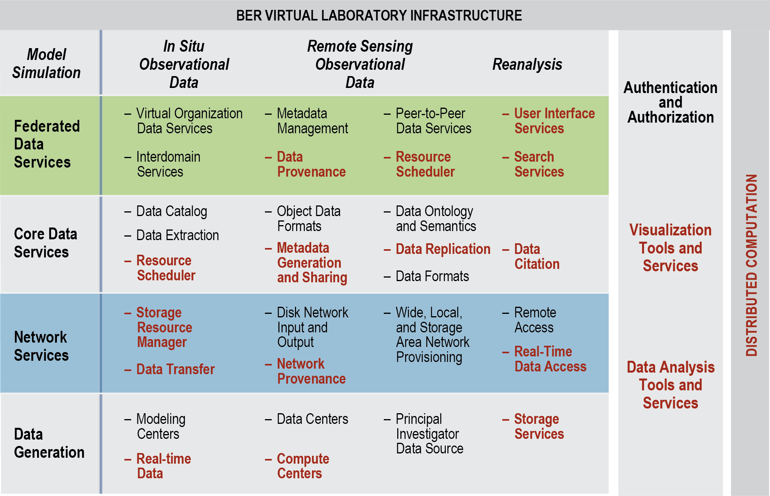
Proposed advances will facilitate the BER Virtual Laboratory
Red text represents associated proposal tasks
ESGF is an integral part of BER’s overall science strategy
Notes:
Red text in the figure represents associated proposal tasks
A Comprehensive, sustainable solution for leveraging and composing national and international, domain-specific, distributed data services and systems must be an integral part of BER’s overall science strategy

Slide 45



























International Climate Network Working Group (ICNWG)
…and many more...

Slide 46
Network connections and collaborations made through the ICNWG
Immediate goal: 4 Gbps (1 PB/month) of sustained disk-to-disk data transfer between ESGF primary data centers
Stretch goal: 16 Gbps (1 PB/week) of sustained disk-to-disk transfer between ESGF primary data centers
Public: (http://icnwg.llnl.gov)
ICNWG infrastructure traverse more than 13,000 miles of networks, spanning two oceans and three continents.

Slide 47
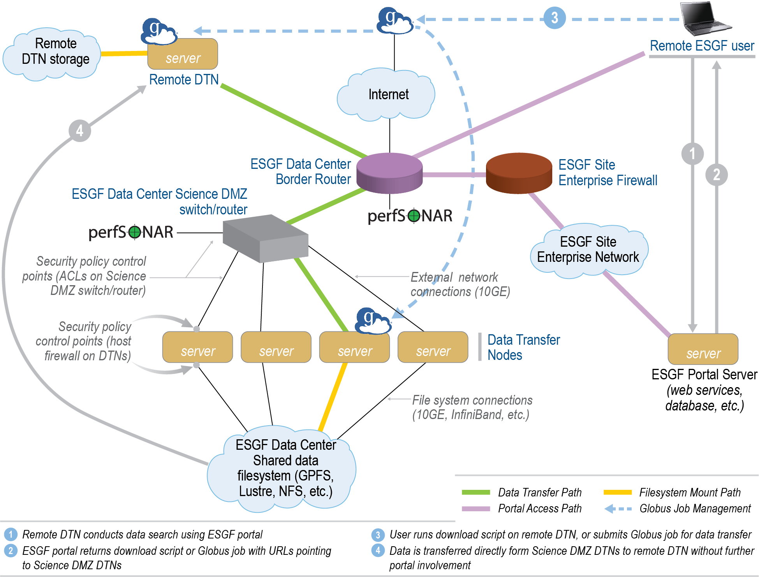
ESGF data center at LLNL lacks the storage resources required to achieve CMIP6 science goals
LLNL sets the standards for networking best practices
Notes:
LLNL sets networking best practices into place to effectively transport tens of petabytes of geophysical data

Slide 48
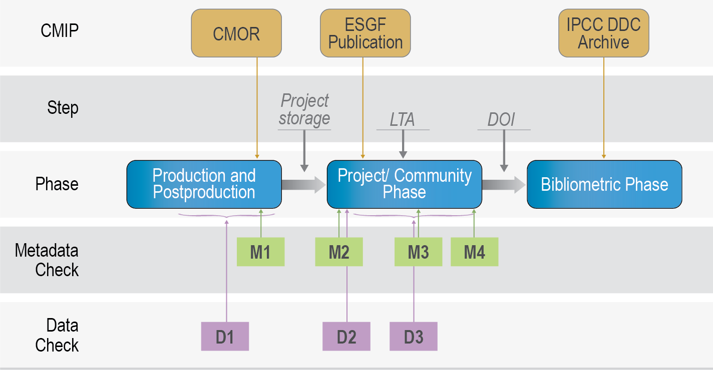
CMIP6 ESGF data publication process
Services operates independently
Resiliency
Notes:
Each of these services operates independently
The classic ESGF file publication will work even if one, or all, of the new services are temporarily offline (resiliency)

Slide 49
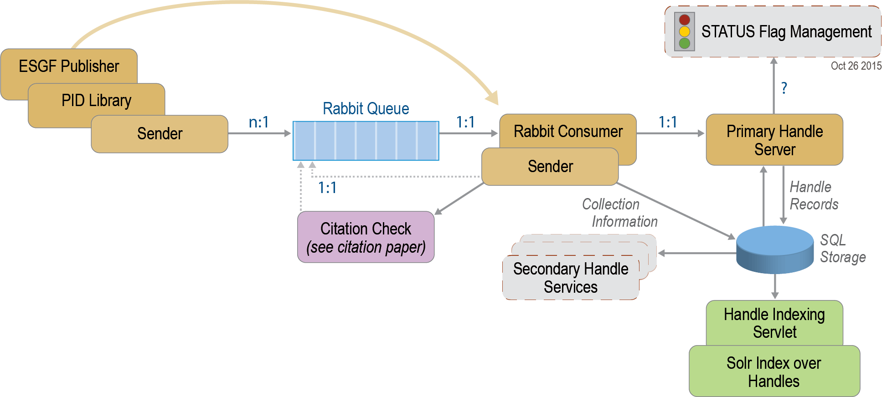
Offline message publication tool and a basic end-user information tool
Persistent identifier (PID)
Notes:
Persistent identifier (PID) associated with the operating system, creation, and owner information are used as the basis for tracking data set replication, versioning, error reporting, and usage in peer-review literature

Slide 50
Compute services for backend implementation
Notes:
Enable data proximal analytics
Create ESGF analytics capabilities by exposing compute resources through well defined interfaces
Allow ESGF users to download the outputs of analysis rather than huge data sets
Web Processing Service Application Programming Interface (WPS API)
API fits multiple backend implementations

Slide 51
What’s next

Slide 52
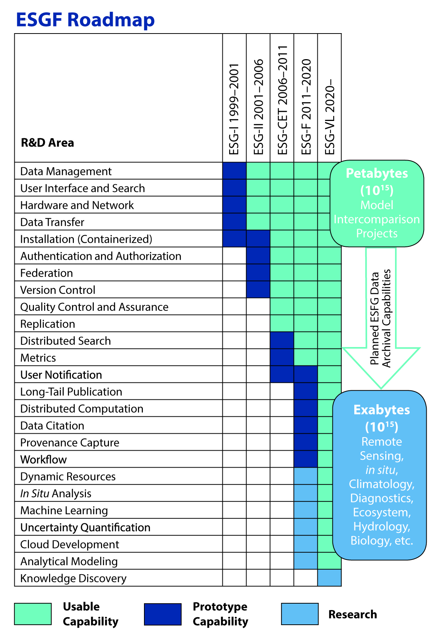
Future work on the horizon
Dynamic resources: Manage and enhance user accessibility.
In situ analysis: Enable users to obtain real-time computational results by performing calculations at the site where data resides.
Machine learning: Find patterns and features in exabyte-scale data, providing users with new insights based on the vast wealth of available data.
Uncertainty quantification: Connect uncertainty in underlying data with the reliability of conclusions.
Cloud development: Enable easy setup of ESGF nodes and services on the cloud, either for permanent management or for transitional computational tasks.
Analytical Modeling: Gauge how long calculations will take on various platforms, so that users can optimize their use of worldwide computational resources.

Slide 53
Future directions and challenges
Scale with “Big Data” produced by higher resolution models, satellites, and instruments
Expand server-side functionality
Server-side processing through WPS (climate indexes, custom algorithms); GIS mapping services (for climate change impact studies at regional and local scale); Facilitate model to observations inter-comparison
Expand direct client access capabilities
Increased support for OPeNDAP based access; Track provenance of complex processing workflows for reproducibility and repeatability; Controlled Vocabularies
Flexible container configurations for Cloud deployment
Instantiate ESGF nodes on demand for short lifetime projects; Environment with elastic allocation of back-end storage and computing resources
Expand to other scientific domains
Biology, Hydrology, Radio Astronomy,…

Slide 54
Websites
Earth System Grid Federation
esgf.llnl.gov
Living documents (i.e., governance, strategic plan, security plan, etc.)
esgf.llnl.gov → “Documents”
Reports
esgf.llnl.gov/reports.html
Conferences
esgf.llnl.gov/conferences.html
Letters of Support
esgf.llnl.gov/letters-of-support.html
Committee Members
esgf.llnl.gov/committee.html
Confluence / JIRA
acme-climate.atlassian.net/ wiki/display/ESGF/Earth+System+Grid+ Federation; confluence/JIRA
GitHub (software repository)
github.com/esgf; software repository website
Network
icnwg.llnl.gov
Tutorial
www.earthsystemcog.org/projects/cog/ tutorials_web; CoG tutorial

Slide 55
Lessons Learned

Slide 56
Lessons learned (1)
ESGF infrastructure is under constant requirements to improve and adapt
ESGF must continue to rely on careful integration of already proven technologies and applications that have been developed by teams over the course of many years (e.., Solr, TDS, UV-CDAT, HTTP, OPeNDAP, SSL,…)
Promote participation and involvement by a large community of stakeholders, managers, and engineers, through an open source, meritocracy based system (not dissimilar to the principles promoted by the Apache Software Foundation, for example)
Establish a flexible governance model from the very beginning, in order to represent the changing interests of all stakeholders, prioritize requirements, and guide the overall system development

Slide 57
Lessons learned (2)
Avoid single points-of-failure in the engineering workforce
Large infrastructure like ESGF should consider scalability and resiliency as major requirements (e.g., data discovery, movement, processing, etc.)
Funding is always a struggle (U.S., EU and other international agencies tend to fund innovative research and new ideas and less prone to support ongoing successful projects such as ESGF)

Slide 58
Discussion
ESGF represents a next-generation agile, open source and modular HPC framework
The ESGF framework aligned with DOE directions of developing advanced, interoperable community tools
Notes:
ESGF represents a next-generation agile, open source and modular HPC framework that can include new scientific discovery and tools as developed
The ESGF framework design is motivated by and aligned with DOE directions of developing advanced, interoperable community tools
The ESGF capabilities and approaches that are being developed have wide-spread utility to many BER Earth and Environmental science missions and to the Earth science community at large

Slide 59
ESGF presentation agenda
Task |  | R&D Area
1.1 |  | Data Management
1.2 |  | User Interface and Search
1.3 |  | Hardware & Network
1.4 |  | Data Transfer
1.5 |  | Installation (Containerized)
1.6 |  | Authentication & Authorization
1.7 |  | Federation
1.8 |  | Quality Control & Assurance
1.9 |  | Replication
1.10 |  | Distributed Search
1.11 |  | Metrics
1.12 |  | User Notification
1.13 |  | Long-tail Publication
1.14 |  | Distributed Computation
1.15 |  | Data Citation
2.1 |  | Provenance Capture
2.2 |  | Workflow
2.3 |  | Dynamic Resources
2.4 |  | In situ Analysis
2.5 |  | Machine Learning
2.6 |  | UQ
2.7 |  | Analytical Modeling
2.8 |  | Mobile Apps
Current capability status:
 | Usable
 | Prototype
 | Research activity
Name | Presentation Title
Dean N. Williams | ESGF Overview
Sasha Ames | Publication, Tracking and Feedback Notification (TFN), and Node Manager
Luca Cinquini | CoG User Interface (UI), Metadata and Search
Charles Doutriaux | Advanced Computational Environments and Data Analytics
Denis Nadeau | Community Data Management System (CDMS) & Climate Model Output Rewriter (CMOR)
Jason Bouttee | Server-side Computing: Application Programming Interface (API)
Zeshawn Shaheen | Diagnostics and Metrics
Williams Hill and Luca Cinquini | Software Installation
Soo Kyung Kim | Machine Learning
Jim McEnerney | Uncertainty Quantification (UQ) and Analytical Modeling (AM)
Ji-Woo Lee | Scientific Contributions of ESGF to Research Communities
Cameron Harr | Hardware & Network and Data Transfer
Matthew Harris | User Support and Documentation

